Slide 1
Welcome to WINNING THE SIX-FIGURE SALE
60 Minute Webinar
.
My goal today is to Challenge Sales Leaders to think differently about how they Inspect, Assess and Coach the Big Deals in their Sales Funnel.
Jeff Goldstein:

Slide 2
Welcome to WINNING THE SIX-FIGURE SALE Thanks for Joining me .
My goal today is to help your Teams WIN More Big Deals
And Learn Important Sales Lessons from the 2008 Recession!
Jeff Goldstein:
SalesClass.ai - Masterclass Nov 19, 2020

Slide 3
Are You in the Right Place?
1st Line Sales Leader
2nd Line Sales Leader Director / VP / GM
Senior Sales Rep
Sales Team Member
YES
Yes
Who wants to make a Bigger Contribution to the team
YES
….

Slide 4
Type in Chat
….
Are You a
1st Line - Sales Leader
2nd Line - Sales Leader
VP, GM
Rep
Other

Slide 5
What this Webinar IS and IS NOT About
This Webinar IS NOT About:
.
Account Planning
Prospecting and Funnel Filling
Handling Objections
Marketing
Notes:
Course Goals
A. Help you Ruthlessly Qualify your Deals
Take off the happy ears and objectively determine if this is a deal you can actually WIN
B. Improve your Win Rate
By following a consistent process, step by step, you’ll ensure you never miss a critical step that will bite you in the ass.

Slide 6
What the Webinar IS About
An Intense Hour
focused on Winning Complex Sales Campaigns
Notes:
Course Goals
A. Help you Ruthlessly Qualify your Deals
Take off the happy ears and objectively determine if this is a deal you can actually WIN
B. Improve your Win Rate
By following a consistent process, step by step, you’ll ensure you never miss a critical step that will bite you in the ass.

Slide 7
A Few Questions - Does Your Team?
Struggle hitting the Forecast?
Have enough Pipeline to meet or exceed the forecast?
Defer Big Deals out of the forecast at the last minute?
Waste time on unqualified opportunities?
Miss important steps or stakeholders in their "Must Win" sales campaigns?
Do they have a repeatable sales process and execution plan?
Do they have a sales strategy other than low price?
Are you happy with the team's Win / Loss / Deferred / No Decision rates?
Do you have a repeatable process to Inspect, Assess and Coach your team's Big Deals?
Notes:
Course Goals
A. Help you Ruthlessly Qualify your Deals
Take off the happy ears and objectively determine if this is a deal you can actually WIN
B. Improve your Win Rate
By following a consistent process, step by step, you’ll ensure you never miss a critical step that will bite you in the ass.

Slide 8
What the Webinar IS About
Dramatically Improving BIG DEAL Forecast Accuracy and Win Rates.
Helping your team Ruthlessly Qualify so they only Spend Time and Resources on Big Deals they can WIN.
Improving “Must Win” Sales Campaign Execution by Covering all the Bases and Never Missing Important Steps or Stakeholders.
Helping Sales Leaders Inspect, Assess and Coach their teams “Big Deals”.
Plus …… Sales Lessons Learned from the 2008 Recession.
Notes:
Course Goals
A. Help you Ruthlessly Qualify your Deals
Take off the happy ears and objectively determine if this is a deal you can actually WIN
B. Improve your Win Rate
By following a consistent process, step by step, you’ll ensure you never miss a critical step that will bite you in the ass.

Slide 9
Right Place?
If your Interested in Winning More Big Deals
You're in the RIGHT Place!

Slide 10
WINNING THE SIX-FIGURE SALE
Agenda:
1
How Can I Help – Jeff Goldstein Introduction
2
The Top 6 Questions you Should be Asking … including lessons from the 2008 Recession
Top Questions - Funnel Inspection - Cadence
Top Questions - Rapid Assessment – Ruthlessly Qualification
Top Questions - Coaching – Covering all your Bases
3
Putting the Ideas to Work for You - Next Steps!

Slide 11
How Can I Help - Intro
1
1
2
3
Engineer P. Eng
VP / GM Country Leader
Eat my own Dog Food
University of Waterloo - Engineering
Wilfred Laurier – Minor in Business
Completed over 3000 Forecast Calls
and 200+ Big Rock Reviews

Slide 12
A Few More Questions Before we Start

Slide 13
Are you Tired of Last Minute Forecast Surprises?
or
Stressed When you Miss Your Commit?

Slide 14
Do you Think Business is Going to Get Better, Worse or Much Worse in the Next Few Months?
….

Slide 15
Type in Chat
….
Will Business Get
Better
Worse
Much Worse
No Idea

Slide 16
What is Going on Inside your Customer Right Now?
CIO / VP Finance

Slide 17
Do you Think Project Approvals are Going to Happen Faster, Slower or Much Slower in the Next Few Months?
….

Slide 18
Type in Chat
….
Will Approvals Happen
Faster
Slower
Much Slower
It Depends

Slide 19
2008 Lesson!
CIOs were directed by VP Finance to
Find Savings…. Opex, Capex, People, Projects?

Slide 20
2008 Lesson!
A bit later I’ll show you the THREE Critical Criteria required for Big Deals to move forward these days!

Slide 21
Let’s get Started!

Slide 22
Top 6 Questions you Should be ASKING to
Ruthlessly Qualify and Win more Big Deals
Including Lessons from the 2008 Recession

Slide 23
WINNING THE SIX-FIGURE SALE My Proven 3-Step System
INSPECT
ASSESS
COACH
Inspect your Sales Funnel, and identify the Big Deals that move the forecast needle
(In and Out Quarter)
Assess the Quality of Your Team’s Must Win Sales Campaigns – Early in the Forecast Process
Help Your Team Close Gaps, Cover All Their Bases – Win More Big Deals

Slide 24
Step 1

Slide 25
Question #1
Do you have an Intentional and Deliberate Cadence to INSPECT the Top 10 Deals
in your Sales Funnel?
(In and Out Quarter)

Slide 26
Little Exercise
If you have a Regular Cadence to Inspect Your Forecast
Type “Stand” in the Chat
….

Slide 27
Little Exercise
If you have a regular Cadence to Inspect The “Top 10 Deals”
in your Funnel … this Quarter
Type “Still Standing” in the Chat
….

Slide 28
Little Exercise
….
If you have a regular Cadence to Inspect The “Top 10 Deals”
In your Funnel … next Quarter
Type “Last Man Standing” in the Chat

Slide 29
95% of all Sales Leaders Have NO Written Plan or Process to:
The Problem
INSPECT
ASSESS
COACH
Inspect your Sales Funnel, and identify the Big Deals that move the forecast needle
(In and Out Quarter)
Assess the Quality of Your Team’s Must Win Sales Campaigns – Early in the Forecast Process
Help Your Team Close Gaps, Cover All Their Bases – Win More Big Deals

Slide 30
Why Don’t you have a Big Deal Cadence? . . No Discipline
No Structured Process or Methodology
Prefer Re-Active Rep Discussions
Depend on Instinct and Experience
No Time

Slide 31
What could be more important than spending . 15% of your Time . Focused on the Deals that Drive your Business?

Slide 32
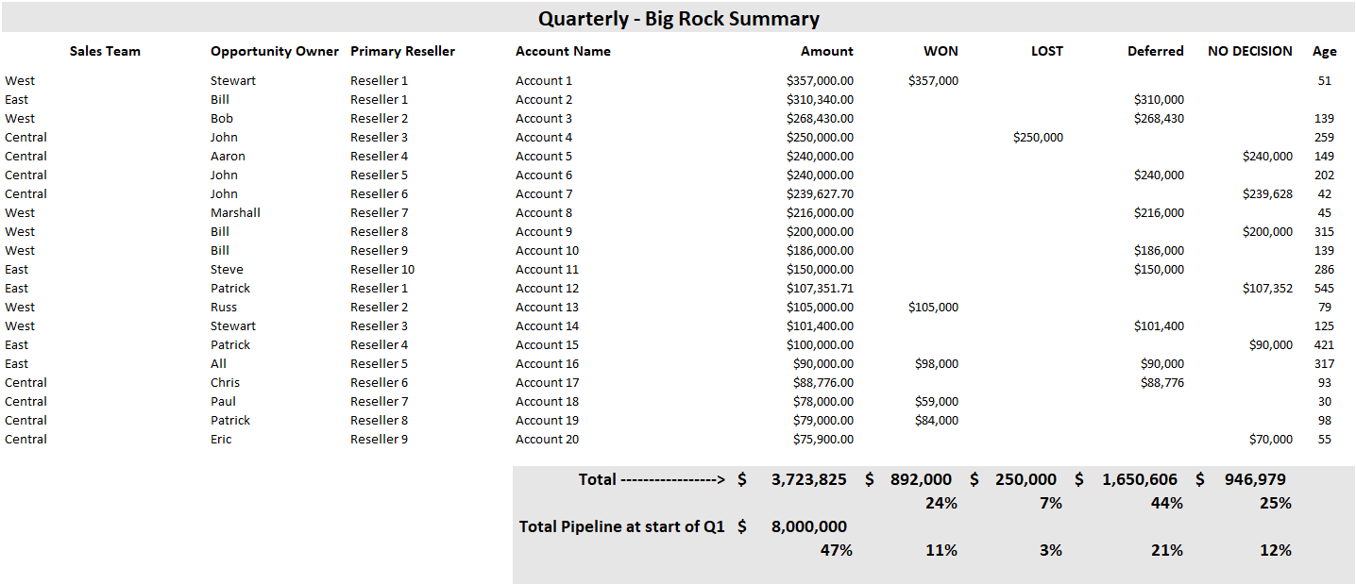
Can you Spot the - BIG PROBLEM ?

Slide 33
THE BIG PROBLEM
WON
LOST
DEFERRED
NO DECISION
24%
7%
44%
25%
Is NO DECISION really a loss?

Slide 34
The Big Opportunity
What Impact Would Winning just One Additional Big Deal “Per Rep, Each Quarter” have on your Sales Results, Forecast Accuracy and Income?

Slide 35
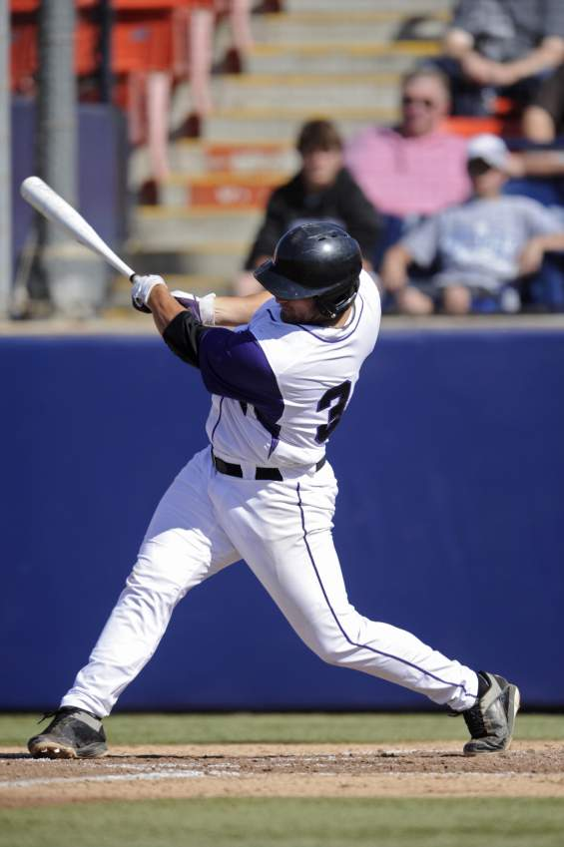
Do the Math
Are your Reps consistently Winning 3 out of 10 Big Deals?
Win 4 out of 7 Big Deals …………. Consistently
Your Batting Average just Doubled to 570%

Slide 36
How to Win ONE Additional Big Deal!
Stop Spending Time on Low Probability Deals.
Instead….. Spend that Time Building Additional Pipeline.
Use the Rapid Assessment Tool to Ruthlessly Qualify and Only Spend Time on Big Deals you Can Win.
Use the Big Rock Review – Deep Dive to Focus Energy, Cover all the Bases and Run Better Sales Campaigns.
Notes:
Stop wasting time on 3 poorly qualified deals and use the time to focus on the winners
Win one more!

Slide 37
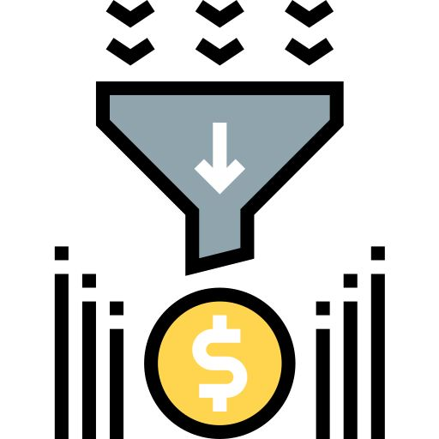
The Problem is the Funnel (poor quality)
Not the Forecast!
Ruthlessly qualify and only spend time and resources
on deals you can WIN!

Slide 38
Action: Develop a Big Deal Cadence
At the Beginning of each Quarter
Identify the Top 10 Deals, In and Out Quarter
Schedule Rapid Assessments for all deals
Schedule Big Rock Review for Must Win sales campaigns
Keep Score during the Quarter
Rinse and Repeat to WIN more Big Deals

Slide 39
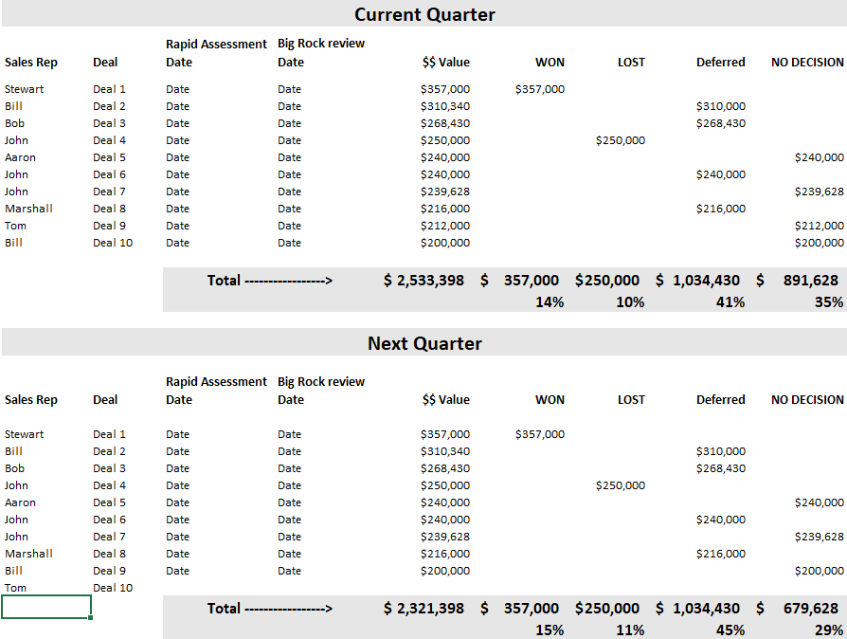
Action: Keep Score

Slide 40
Question #2
Can you Name the Top 10 Steps and Stakeholders in a Complex Sales Campaign?

Slide 41
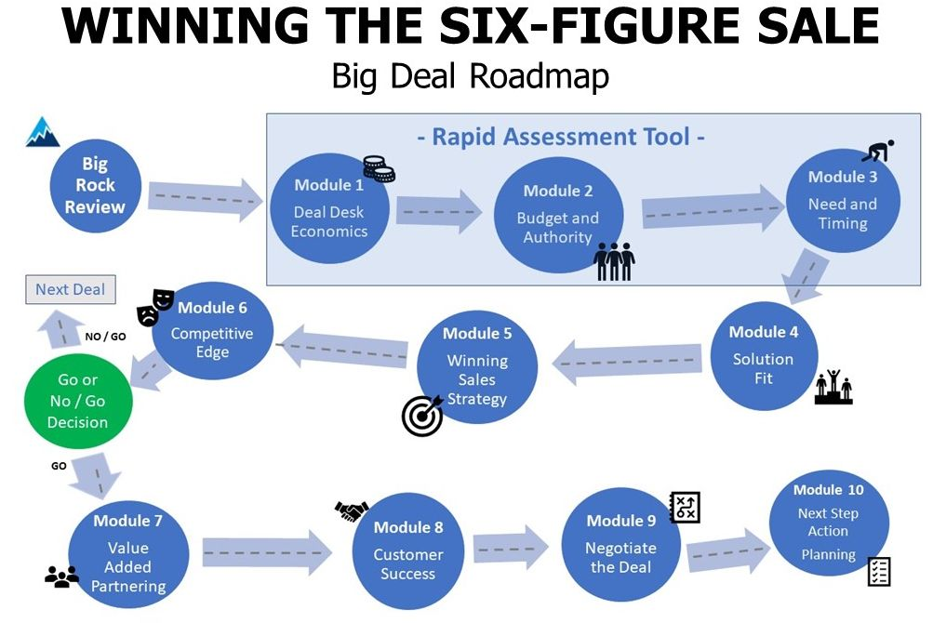

Slide 42
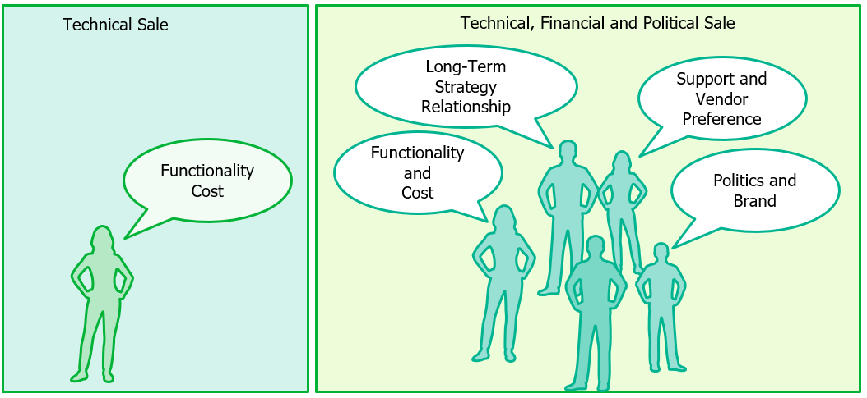
Six-Figure Sales Campaigns include both Technical and ….

Slide 43
Six-Figure Sales Campaigns include both Technical and Economic/Political Campaigns
Notes:
In Tech we usually focus on Technical Campaign
IBM / EMC were classic in running Political campaigns (Banks, Telco's)
Buys enjoyed the EMC lifestyle… hard to play that game without $$$

Slide 44
The Number of Stakeholders increases Deal Complexity

Slide 45
The Big Deal Roadmap helps ensure you
Never Miss
Important STEPS or Stakeholders
in your Complex Sales Campaigns

Slide 46
Action: Download Big Deal Roadmap
http://www.salesleadersonly.com/salesclass
Find it in the Handout Section

Slide 47
Step 2

Slide 48
Question #3
Do you have a Process to ASSESS
the Quality of your
Top 10 Sales Campaigns early in the Forecast Process?
(In and Out Quarter)

Slide 49
There are a lot of moving parts in a Complex Sales Campaign - The Rapid Assessment Tool – .
can help quickly qualify a deal

Slide 50
Question #3
- Rapid Assessment Tool – .
Think “BANT”

Slide 51
BANT = Ruthless Qualification
B = Budget
A = Authority
N = Need / Business Outcomes
T = Timing

Slide 52
# 3 BANT: B = Budget
- Has the Budget Been Approved?
- Has the Budget Been Released?
- What’s Changed in the Customer’s Approval Process… (hint… it’s not nothing)!

Slide 53
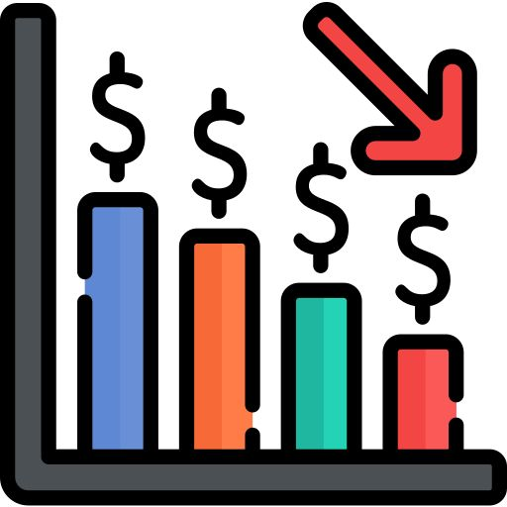
2008 Lesson!
IT Directors and Managers had their Signing Authority reduced, and often didn’t know it until they tried to process a PO.

Slide 54
# 3 BANT: A = Authority
Are you Speaking with the Decision Maker who has Final Authority to spend the budget?
Have you met them in Person / Video Zoom?
Hint…. today it’s probably not the Technical decision maker

Slide 55
How Wide and Deep you Selling?

Slide 56
2008 Lesson!
Your need Access to Power to Qualify the
$$$

Slide 57
# 3 BANT: N = Need
What Needs and Business Outcomes will the Solution address?
Will your solution provide < 12 month ROI?
Is it funded with Capex or Opex?

Slide 58
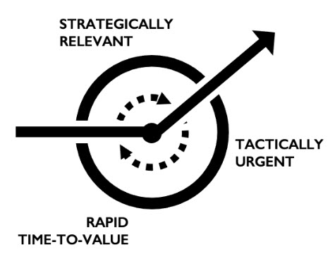
2008 Lesson!
The projects getting approved were
Bob Apollo - LinkedIn

Slide 59
# 3 BANT: T = Timing
What is the Compelling Event that will ensure the deal closes as forecasted?
What happens if you miss the Compelling Event?
Hint… if nothing happens, it’s not compelling

Slide 60
2008 Lesson!
Sales cycles got longer, sometimes way longer and “No Decision” was a real issue

Slide 61
BANT = Rapid Assessment Tool
B = Budget
A = Authority
N = Need / Business Outcomes
T = Timing

Slide 62
Action: Download Relationship Map
http://www.salesleadersonly.com/salesclass
Find it in the Handout Section

Slide 63
Step 3

Slide 64
Question #4
How will you Coach your team to help them cover all the bases in their Most Strategic Opportunities?

Slide 66
Question #4
Execute a Big Rock Review on your
“Must Win” Sales Campaigns
both In and Out Quarter
Takes 1 Hour even for Complex Deals!

Slide 67
Question #4
The Big Rock Review helps ensure you never miss Important Steps or Stakeholders in a Complex Sales Campaign

Slide 68
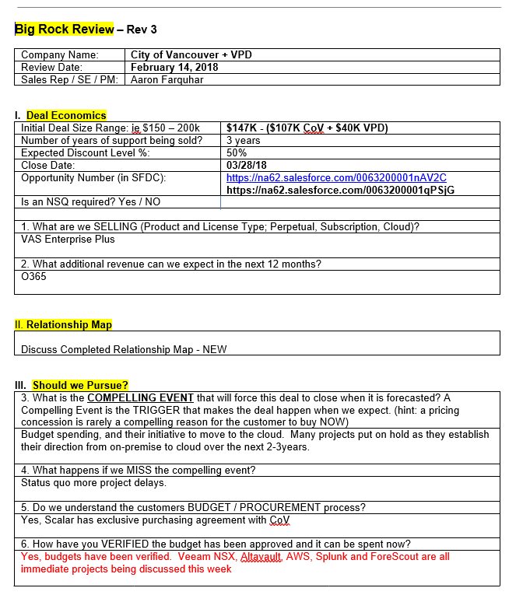
25 Question - Big Rock Review

Slide 70
Question #5
What are you going to STOP doing to make time to Inspect, Assess and Coach your Team’s Top Deals?

Slide 71
Question #5
You need to be
Intentional and Deliberate
to create a new habit

Slide 72
Question #6
How Aggressively should you be Managing your Teams Performance Right Now?

Slide 73
2008 Lesson!
The Reps on the bottom of the Sales Leaderboard Before the Recession Were the SAME reps on the bottom long After the Recession was over

Slide 74
2008 Lesson!
But…. It’s actually your TOP reps you should be Most worried about! They aren’t making any $$ and are a Flight Risk!

Slide 75
Action: What Should you Do Right Now
2008 Lesson – Top Performers!
1. Complete “Stay Interviews” with Top Reps
2. Have your Boss reach out and show interest

Slide 76
2008 Lesson - Bottom Performers!
3. Be Explicit about Expectations with the Bottom Reps
4. Put them on a PIP now
5. Document, document, document
6. Be Ready to Pull the Trigger when you can

Slide 77
Action: Be Pro-Active
Be Pro-Active about your People Management - Right Now or pay the price later on!

Slide 78
WINNING THE SIX-FIGURE SALE - Summary
Accelerate

Slide 79
Question Summary
Do you have a Cadence to Review your Top 10 Deals?
Can you Name the Top 10 Steps and Stakeholders in a Complex Sales Campaign?
Do you have a Process to Inspect, Assess and Coach your Big Deals?
Are you Ruthlessly Qualifying with the Rapid Assessment Tool (BANT)?
What will you Stop doing to spend more time on your Big Deals?
How Aggressively should you be Managing your Teams Performance Right Now

Slide 80
2008 Lesson Summary
CIO are being directed to Reduce Budgets.
Signing Authority is being reduced, often without notice.
You need Access to Power to Qualify $$.
Projects are getting approved only if they are Strategically Relevant, Tactically urgent and provide Rapid Time-to-Value.
Sales Cycles are getting Longer, sometimes way longer?
The Reps on the Bottom of the Leaderboard don’t Improve during a Recession

Slide 81
Next Steps / Q & A
3
Questions?

Slide 82
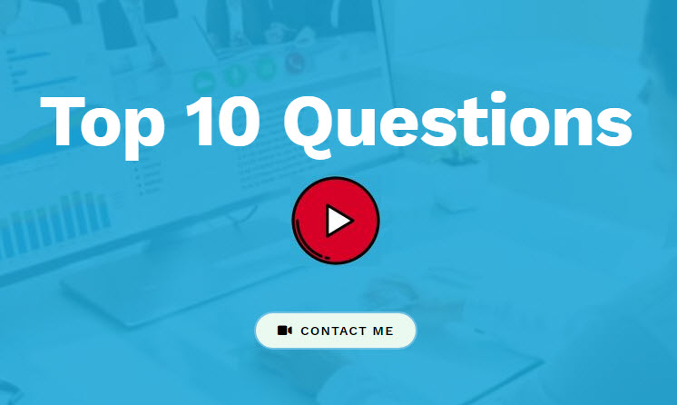
Action: Download Free Webinar Assets
http://www.salesleadersonly.com/salesclass
Big Deal Roadmap Infographic:
Relationship Map:
Top 10 Questions - Video Series:

Slide 83
Action: Schedule a Free Assessment Call
Would WINNING THE SIX-FIGURE SALE 1-Hour Masterclass benefit your Sales Leadership Team?
Would WINNING THE SIX-FIGURE SALE ½-Day Training Program benefit your Sales team?
Lets connect and see if I can add value.
Email Jeff@SalesLeadersOnly.com
Icons made by Freepik from www.flaticon.com

Slide 84
Action: Let’s Connect on LinkedIn
www.LinkedIn.com/in/jeffgoldstein2
Icons made by Freepik from www.flaticon.com

Slide 85
Action: Get Notified
www.SalesLeadersOnly.com/newbook
Icons made by Freepik from www.flaticon.com

Slide 86
Thanks – See you at the Top of the Leaderboard!

